Slide 1
Probability
9.8 Multi-Armed bandits
Alex Tsun

Slide 2
Agenda
The Multi-ARmed Bandit (MAB) Problem
Greedy/Epsilon-Greedy
Upper Confidence Bound (UCB)
Thompson Sampling
Modern Hypothesis Testing

Slide 3
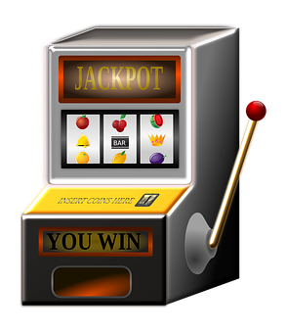
Multi-Armed Bandit (MAB) Problem
K Slot Machines {1,2,...,K} (aka “Bandits” with “Arms”).

Slide 4

Multi-Armed Bandit (MAB) Problem
K Slot Machines {1,2,...,K} (aka “Bandits” with “Arms”).
At each time step t=1,2,...,T: Pull an arm a_{t} {1,2,...,K} and observe random reward (each arm is independent, and has some reward distribution which doesn’t change over time).

Slide 5
Multi-Armed Bandit (MAB) Problem
K Slot Machines {1,2,...,K} (aka “Bandits” with “Arms”).
At each time step t=1,2,...,T: Pull an arm a_{t} {1,2,...,K} and observe random reward (each arm is independent, and has some reward distribution which doesn’t change over time).
Goal: Maximize total (expected) reward after T time steps.

Slide 6
Multi-Armed Bandit (MAB) Problem
K Slot Machines {1,2,...,K} (aka “Bandits” with “Arms”).
At each time step t=1,2,...,T: Pull an arm a_{t} {1,2,...,K} and observe random reward (each arm is independent, and has some reward distribution which doesn’t change over time).
Goal: Maximize total (expected) reward after T time steps.
Problem: At each time step, decide which arm to pull based on past history of rewards.

Slide 7
Multi-Armed Bandit (MAB) Problem
Below has the reward distribution of each of the K=3 arms.
What’s your strategy to maximize your total (expected) reward?

Slide 8
Multi-Armed Bandit (MAB) Problem
Below has the reward distribution of each of the K=3 arms.
What’s your strategy to maximize your total (expected) reward?
Pull arm 2 every time since it has the highest expected reward!

Slide 9
Multi-Armed Bandit (MAB) Problem
Well actually, we don’t know the reward distributions :(.

Slide 10
Multi-Armed Bandit (MAB) Problem
Well actually, we don’t know the reward distributions :(.
Have to estimate all K expectations

Slide 11
Multi-Armed Bandit (MAB) Problem
Well actually, we don’t know the reward distributions :(.
Have to estimate all K expectations, WHILE simultaneously maximizing reward!

Slide 12
Multi-Armed Bandit (MAB) Problem
Well actually, we don’t know the reward distributions :(.
Have to estimate all K expectations, WHILE simultaneously maximizing reward!
This is a hard problem - we know nothing about the K reward distributions!

Slide 13
Multi-Armed Bandit (MAB) Problem
Need to balance the tradeoff between:
Exploitation: Pulling arm(s) we know to be “good”.
Exploration: Pulling other arms in the hopes they are also “good” or even better.

Slide 14
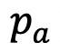
Bernoulli Bandits
We will handle the case of Bernoulli-bandits. That is, reward of arm a {1,2,...,K} is Ber( ) .

Slide 15
Bernoulli Bandits
We will handle the case of Bernoulli-bandits. That is, reward of arm a {1,2,...,K} is Ber( ) .
We don’t know these!

Slide 16
Bernoulli Bandits
We will handle the case of Bernoulli-bandits. That is, reward of arm a {1,2,...,K} is Ber( ) .
Observe: The expected reward of arm a is just (expectation of Bernoulli).
We don’t know these!

Slide 17

Regret
Regret is the difference between:
The best possible expected reward (always pull the best arm)
The actual reward you got

Slide 18
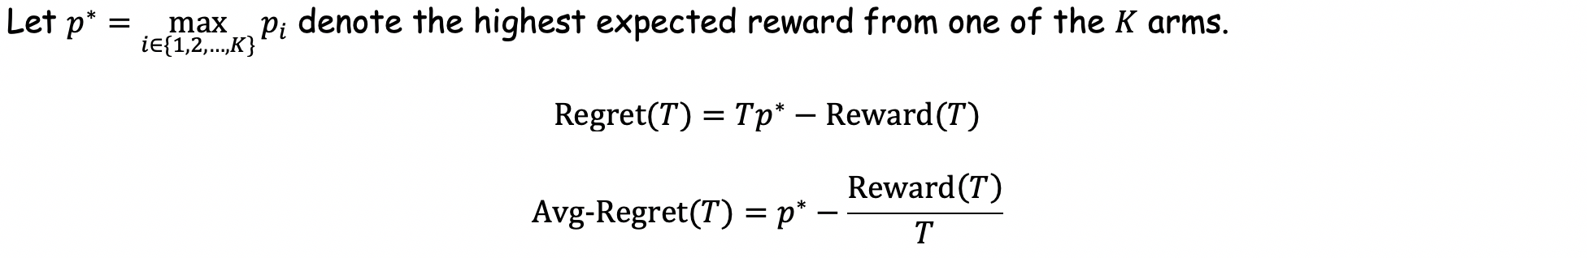
Regret
Regret is the difference between:
The best possible expected reward (always pull the best arm)
The actual reward you got

Slide 19
Regret
Regret is the difference between:
The best possible expected reward (always pull the best arm)
The actual reward you got
At some “time” T (after T arm pulls)

Slide 20
Regret
Regret is the difference between:
The best possible expected reward (always pull the best arm)
The actual reward you got
At some “time” T (after T arm pulls)

Slide 21
Regret
Regret is the difference between:
The best possible expected reward (always pull the best arm)
The actual reward you got
At some “time” T (after T arm pulls)

Slide 22
Regret
Regret is the difference between:
The best possible expected reward (always pull the best arm)
The actual reward you got

Slide 23

Regret
Regret is the difference between:
The best possible expected reward (always pull the best arm)
The actual reward you got
Want Avg-Regret(T) → 0 as T → . Minimizing Regret = Maximizing Reward.

Slide 24
Regret
Regret is the difference between:
The best possible expected reward (always pull the best arm)
The actual reward you got
Want Avg-Regret(T) → 0 as T → . Minimizing Regret = Maximizing Reward.
Random Quote: “I'd rather regret the things I've done than regret the things I haven't done.” - Anonymous

Slide 25

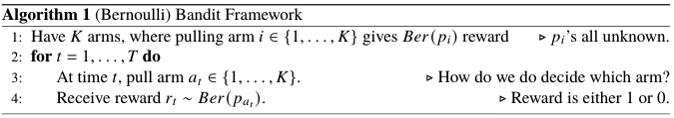
(Bernoulli) Bandit Framework
How do we choose an arm at each time step (depending on past history), to maximize our total reward?

Slide 26
(Bernoulli) Bandit Framework
How do we choose an arm at each time step (depending on past history), to maximize our total reward?

Slide 27
(Bernoulli) Bandit Framework
How do we choose an arm at each time step (depending on past history), to maximize our total reward?

Slide 28
(Bernoulli) Bandit Framework
How do we choose an arm at each time step (depending on past history), to maximize our total reward?
This is the focus of the rest of this lecture!

Slide 29

Motivation: Clinical Trials
K = 4 Arms (Treatments)

Slide 30
Motivation: Clinical Trials
K = 4 Arms (Treatments)
For patient t, prescribe treatment a_{t} in {1,2,3,4}.

Slide 31
Motivation: Clinical Trials
K = 4 Arms (Treatments)
For patient t, prescribe treatment a_{t} in {1,2,3,4}.
Observe reward r_{t} in {0, 1}. (1 if healed, 0 if not)

Slide 32
Motivation: Clinical Trials
K = 4 Arms (Treatments)
For patient t, prescribe treatment a_{t} in {1,2,3,4}.
Observe reward r_{t} in {0, 1}. (1 if healed, 0 if not)
Maximize: Total number of patients healed.

Slide 33

Motivation: Recommending Movies
K Movies
For visitor t, recommend movie a_{t} in {1,2,...,K}.

Slide 34
Motivation: Recommending Movies
K Movies
For visitor t, recommend movie a_{t} in {1,2,...,K}.
Observe reward r_{t} in {1,2,3,4,5}. (rating)
Maximize: Total/average rating of recommendations.

Slide 35
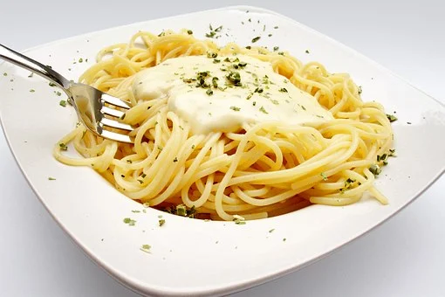
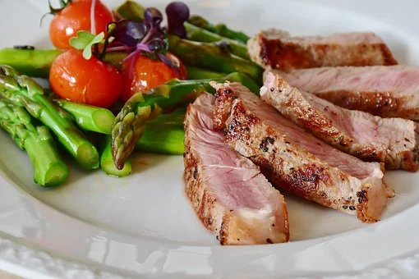
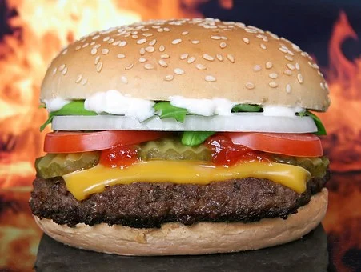
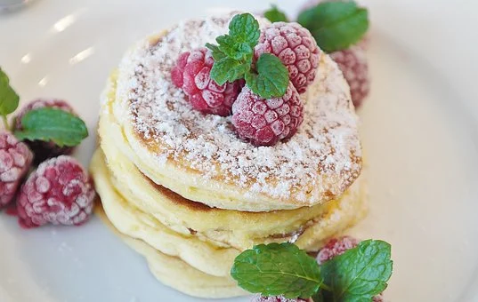
Motivation: Real Life??
(Food)
K Cuisines/Dishes (a ton)
For meal t, eat dish a_{t} in {1,2,...,K}.

Slide 36
Motivation: Real Life??
(Food)
K Cuisines/Dishes (a ton)
For meal t, eat dish a_{t} in {1,2,...,K}.
Observe reward r_{t} in {1,2,3,4,5}. (happiness rating)
Maximize: Total/average happiness :)

Slide 37
Motivation: Real Life??
(Food)
K Cuisines/Dishes (a ton)
For meal t, eat dish a_{t} in {1,2,...,K}.
Observe reward r_{t} in {1,2,3,4,5}. (happiness rating)
Maximize: Total/average happiness :)
The Question of the Day: Explore or Exploit????

Slide 38

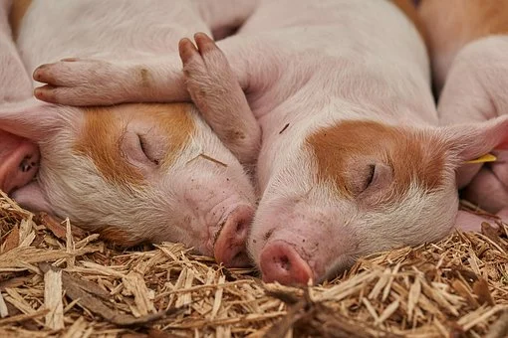


Motivation: Real Life??
(Activities)
K Activities
On day t, do activity a_{t} n {1,2,...,K}.
Observe reward r_{t} in {1,2,3,4,5}. (happiness rating)
Maximize: Total/average happiness :)
The Question of the Day: Explore or Exploit????

Slide 39

Any Ideas on what strategy we can use???

Slide 40
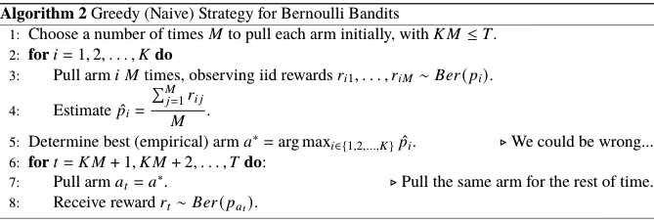
Greedy (Naive) Algorithm

Slide 41
Greedy (Naive) Algorithm

Slide 42
Greedy (Naive) Algorithm

Slide 43
Greedy (Naive) Algorithm

Slide 44
Greedy (Naive) Algorithm
If we make a mistake, we will regret our decision for the rest of time….
Can we not do all of our exploration at the beginning?

Slide 45
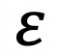
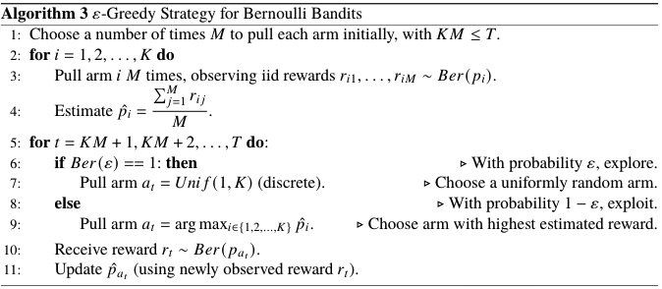
Epsilon-Greedy Algorithm
Explore with probability epsilon!

Slide 46
Epsilon-Greedy Algorithm
Explore with probability epsilon!

Slide 47
Epsilon-Greedy Algorithm
Explore with probability epsilon!

Slide 48
Epsilon-Greedy Algorithm
Explore with probability epsilon!

Slide 49
Epsilon-Greedy Algorithm
Explore with probability epsilon!
Can we explore more “naturally”?

Slide 50
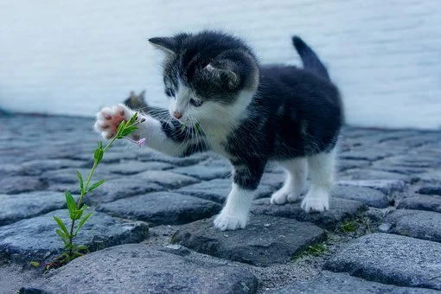
Random Picture
Definition of
Expectation
Explore like a
new-born kitten!

Slide 51

Upper Confidence Bound (UCB) Algorithm
This algorithm constructs confidence intervals for the estimates of each arm, and chooses the arm with the highest upper confidence bound (if the confidence interval is [a,b], we compare only the value of b)

Slide 52
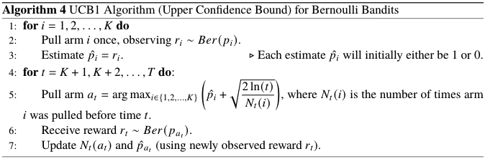
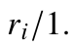
Upper Confidence Bound (UCB) Algorithm
This algorithm constructs confidence intervals for the estimates of each arm, and chooses the arm with the highest upper confidence bound (if the confidence interval is [a,b], we compare only the value of b)

Slide 53
Upper Confidence Bound (UCB) Algorithm
This algorithm constructs confidence intervals for the estimates of each arm, and chooses the arm with the highest upper confidence bound (if the confidence interval is [a,b], we compare only the value of b)

Slide 54
Upper Confidence Bound (UCB) Algorithm
This algorithm constructs confidence intervals for the estimates of each arm, and chooses the arm with the highest upper confidence bound (if the confidence interval is [a,b], we compare only the value of b)
Point estimate/
Max-likelihood estimate

Slide 55
Upper Confidence Bound (UCB) Algorithm
This algorithm constructs confidence intervals for the estimates of each arm, and chooses the arm with the highest upper confidence bound (if the confidence interval is [a,b], we compare only the value of b)
Takes the upper part of of the confidence interval.
Point estimate/
Max-likelihood estimate

Slide 56
Upper Confidence Bound (UCB) Algorithm
This algorithm constructs confidence intervals for the estimates of each arm, and chooses the arm with the highest upper confidence bound (if the confidence interval is [a,b], we compare only the value of b)

Slide 57
Upper Confidence Bound (UCB) Algorithm
This algorithm constructs confidence intervals for the estimates of each arm, and chooses the arm with the highest upper confidence bound (if the confidence interval is [a,b], we compare only the value of b)

Slide 58
Upper Confidence Bound (UCB) Algorithm
This algorithm constructs confidence intervals for the estimates of each arm, and chooses the arm with the highest upper confidence bound (if the confidence interval is [a,b], we compare only the values of b).
Exploration is “baked in”: the frequently pulled arms will have narrow confidence intervals (and hence a lower upper bound), and the less-frequently pulled arms will have wide intervals (and hence a higher upper bound).

Slide 59
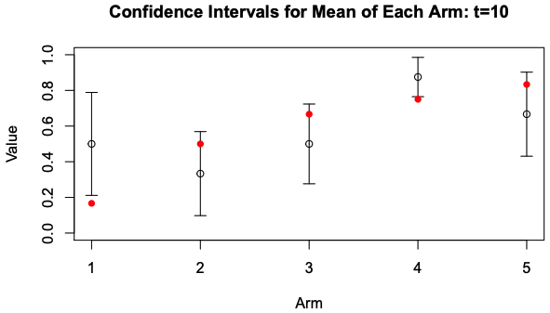
UCB: Confidence Intervals over Time

Slide 60
UCB: Confidence Intervals over Time
Red Dots: True Means

Slide 61
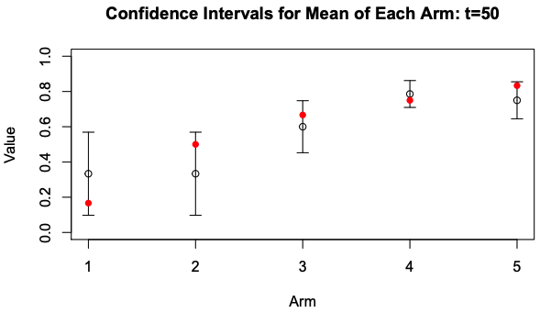
UCB: Confidence Intervals over Time

Slide 62
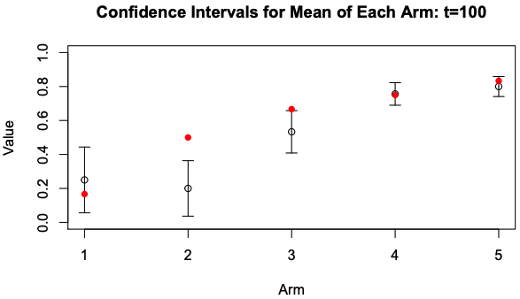
UCB: Confidence Intervals over Time

Slide 63
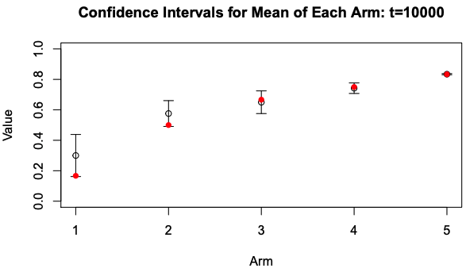
UCB: Confidence Intervals over Time

Slide 64
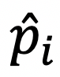
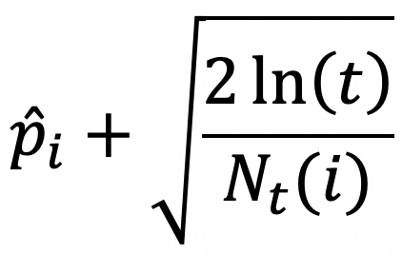
UCB Example
Arm ( i ) | True p_{i} | # Times Pulled | Total Reward |  | UCB ( )
1 | 0.5
2 | 0.2
3 | 0.9
Time ( t ) | Arm Pulled ( a_{t} ) | Reward ( r_{t} )

Slide 65
UCB Example
Arm ( i ) | True p_{i} | # Times Pulled | Total Reward |  | UCB ( )
1 | 0.5
2 | 0.2
3 | 0.9
Time ( t ) | Arm Pulled ( a_{t} ) | Reward ( r_{t} )
We don’t actually know these...

Slide 66
UCB Example
Arm ( i ) | True p_{i} | # Times Pulled | Total Reward |  | UCB ( )
1 | 0.5
2 | 0.2
3 | 0.9
Time ( t ) | Arm Pulled ( a_{t} ) | Reward ( r_{t} )
1 | 1 | 0
At time 1, we pull arm 1, and observe either a 1 (with probability 0.5) or a 0 (with probability 1-0.5).
We happen to observe a 0.

Slide 67
UCB Example
Arm ( i ) | True p_{i} | # Times Pulled | Total Reward |  | UCB ( )
1 | 0.5 | 1 | 0 | 0/1
2 | 0.2
3 | 0.9
Time ( t ) | Arm Pulled ( a_{t} ) | Reward ( r_{t} )
1 | 1 | 0

Slide 68
UCB Example
Arm ( i ) | True p_{i} | # Times Pulled | Total Reward |  | UCB ( )
1 | 0.5 | 1 | 0 | 0/1
2 | 0.2
3 | 0.9
Time ( t ) | Arm Pulled ( a_{t} ) | Reward ( r_{t} )
2 | 2 | 0
At time 2, we pull arm 2, and observe either a 1 (with probability 0.2) or a 0 (with probability 1-0.2).
We happen to observe a 0.

Slide 69
UCB Example
Arm ( i ) | True p_{i} | # Times Pulled | Total Reward |  | UCB ( )
1 | 0.5 | 1 | 0 | 0/1
2 | 0.2 | 1 | 0 | 0/1
3 | 0.9
Time ( t ) | Arm Pulled ( a_{t} ) | Reward ( r_{t} )
2 | 2 | 0
Pi is the average Reward

Slide 70
UCB Example
Arm ( i ) | True p_{i} | # Times Pulled | Total Reward |  | UCB ( )
1 | 0.5 | 1 | 0 | 0/1
2 | 0.2 | 1 | 0 | 0/1
3 | 0.9
Time ( t ) | Arm Pulled ( a_{t} ) | Reward ( r_{t} )
3 | 3 | 1
At time 3, we pull arm 3, and observe either a 1 (with probability 0.9) or a 0 (with probability 1-0.9).
We happen to observe a 1.

Slide 71
UCB Example
Arm ( i ) | True p_{i} | # Times Pulled | Total Reward |  | UCB ( )
1 | 0.5 | 1 | 0 | 0/1
2 | 0.2 | 1 | 0 | 0/1
3 | 0.9 | 1 | 1 | 1/1
Time ( t ) | Arm Pulled ( a_{t} ) | Reward ( r_{t} )
3 | 3 | 1

Slide 72
UCB Example
Arm ( i ) | True p_{i} | # Times Pulled | Total Reward |  | UCB ( )
1 | 0.5 | 1 | 0 | 0/1
2 | 0.2 | 1 | 0 | 0/1
3 | 0.9 | 1 | 1 | 1/1
Time ( t ) | Arm Pulled ( a_{t} ) | Reward ( r_{t} )
4
At time 4, we must compute all our upper confidence bounds, and choose the best one.

Slide 73
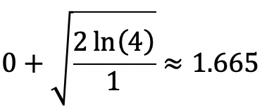
UCB Example
Arm ( i ) | True p_{i} | # Times Pulled | Total Reward |  | UCB ( )
1 | 0.5 | 1 | 0 | 0/1 | 1.665
2 | 0.2 | 1 | 0 | 0/1
3 | 0.9 | 1 | 1 | 1/1
Time ( t ) | Arm Pulled ( a_{t} ) | Reward ( r_{t} )
4
At time 4, we must compute all our upper confidence bounds, and choose the best one.

Slide 74
UCB Example
Arm ( i ) | True p_{i} | # Times Pulled | Total Reward |  | UCB ( )
1 | 0.5 | 1 | 0 | 0/1 | 1.665
2 | 0.2 | 1 | 0 | 0/1 | 1.665
3 | 0.9 | 1 | 1 | 1/1
Time ( t ) | Arm Pulled ( a_{t} ) | Reward ( r_{t} )
4
At time 4, we must compute all our upper confidence bounds, and choose the best one.

Slide 75
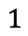
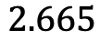
UCB Example
Arm ( i ) | True p_{i} | # Times Pulled | Total Reward |  | UCB ( )
1 | 0.5 | 1 | 0 | 0/1 | 1.665
2 | 0.2 | 1 | 0 | 0/1 | 1.665
3 | 0.9 | 1 | 1 | 1/1 | 2.665
Time ( t ) | Arm Pulled ( a_{t} ) | Reward ( r_{t} )
4
At time 4, we must compute all our upper confidence bounds, and choose the best one.

Slide 76
UCB Example
Arm ( i ) | True p_{i} | # Times Pulled | Total Reward |  | UCB ( )
1 | 0.5 | 1 | 0 | 0/1 | 1.665
2 | 0.2 | 1 | 0 | 0/1 | 1.665
3 | 0.9 | 1 | 1 | 1/1 | 2.665
Time ( t ) | Arm Pulled ( a_{t} ) | Reward ( r_{t} )
4 | 3
At time 4, arm 3 has the highest UCB so we pull it.

Slide 77
UCB Example
Arm ( i ) | True p_{i} | # Times Pulled | Total Reward |  | UCB ( )
1 | 0.5 | 1 | 0 | 0/1 | 1.665
2 | 0.2 | 1 | 0 | 0/1 | 1.665
3 | 0.9 | 1 | 1 | 1/1 | 2.665
Time ( t ) | Arm Pulled ( a_{t} ) | Reward ( r_{t} )
4 | 3 | 0
At time 4, arm 3 has the highest UCB so we pull it. We observe a reward of 0.

Slide 78
UCB Example
Arm ( i ) | True p_{i} | # Times Pulled | Total Reward |  | UCB ( )
1 | 0.5 | 1 | 0 | 0/1
2 | 0.2 | 1 | 0 | 0/1
3 | 0.9 | 2 | 1 | 1/2
Time ( t ) | Arm Pulled ( a_{t} ) | Reward ( r_{t} )
4 | 3 | 0
At time 4, arm 3 has the highest UCB so we pull it. We observe a reward of 0.
Then we update our estimate for p₃.

Slide 79
UCB Example
Arm ( i ) | True p_{i} | # Times Pulled | Total Reward |  | UCB ( )
1 | 0.5 | 1 | 0 | 0/1
2 | 0.2 | 1 | 0 | 0/1
3 | 0.9 | 2 | 1 | 1/2
Time ( t ) | Arm Pulled ( a_{t} ) | Reward ( r_{t} )
5
At time 5, we must compute all our upper confidence bounds, and choose the best one.

Slide 80
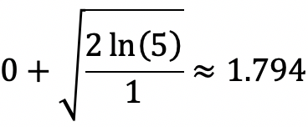
UCB Example
Arm ( i ) | True p_{i} | # Times Pulled | Total Reward |  | UCB ( )
1 | 0.5 | 1 | 0 | 0/1 | 1.794
2 | 0.2 | 1 | 0 | 0/1
3 | 0.9 | 2 | 1 | 1/2
Time ( t ) | Arm Pulled ( a_{t} ) | Reward ( r_{t} )
5
At time 5, we must compute all our upper confidence bounds, and choose the best one.

Slide 81
UCB Example
Arm ( i ) | True p_{i} | # Times Pulled | Total Reward |  | UCB ( )
1 | 0.5 | 1 | 0 | 0/1 | 1.794
2 | 0.2 | 1 | 0 | 0/1 | 1.794
3 | 0.9 | 2 | 1 | 1/2
Time ( t ) | Arm Pulled ( a_{t} ) | Reward ( r_{t} )
5
At time 5, we must compute all our upper confidence bounds, and choose the best one.

Slide 82
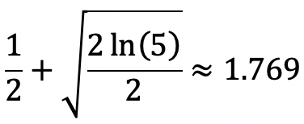
UCB Example
Arm ( i ) | True p_{i} | # Times Pulled | Total Reward |  | UCB ( )
1 | 0.5 | 1 | 0 | 0/1 | 1.794
2 | 0.2 | 1 | 0 | 0/1 | 1.794
3 | 0.9 | 2 | 1 | 1/2 | 1.769
Time ( t ) | Arm Pulled ( a_{t} ) | Reward ( r_{t} )
5
At time 5, we must compute all our upper confidence bounds, and choose the best one.

Slide 83
UCB Example
Arm ( i ) | True p_{i} | # Times Pulled | Total Reward |  | UCB ( )
1 | 0.5 | 1 | 0 | 0/1 | 1.794
2 | 0.2 | 1 | 0 | 0/1 | 1.794
3 | 0.9 | 2 | 1 | 1/2 | 1.769
Time ( t ) | Arm Pulled ( a_{t} ) | Reward ( r_{t} )
5 | 1
At time 5, arms 1 and 2 have the highest UCB so we pull one of them (let’s break ties by choosing the smaller index arm). So we pull arm 1.

Slide 84
UCB Example
Arm ( i ) | True p_{i} | # Times Pulled | Total Reward |  | UCB ( )
1 | 0.5 | 1 | 0 | 0/1 | 1.794
2 | 0.2 | 1 | 0 | 0/1 | 1.794
3 | 0.9 | 2 | 1 | 1/2 | 1.769
Time ( t ) | Arm Pulled ( a_{t} ) | Reward ( r_{t} )
5 | 1 | 0
At time 5, arms 1 and 2 have the highest UCB so we pull one of them (let’s break ties by choosing the smaller index arm). So we pull arm 1.
We observe a reward of 0.

Slide 85
UCB Example
Arm ( i ) | True p_{i} | # Times Pulled | Total Reward |  | UCB ( )
1 | 0.5 | 2 | 0 | 0/2
2 | 0.2 | 1 | 0 | 0/1
3 | 0.9 | 2 | 1 | 1/2
Time ( t ) | Arm Pulled ( a_{t} ) | Reward ( r_{t} )
5 | 1 | 0
At time 5, arms 1 and 2 have the highest UCB so we pull one of them (let’s break ties by choosing the smaller index arm). So we pull arm 1.
We observe a reward of 0. Then we update our estimate for p₁.

Slide 86
UCB Example
Arm ( i ) | True p_{i} | # Times Pulled | Total Reward |  | UCB ( )
1 | 0.5 | 2 | 0 | 0/2
2 | 0.2 | 1 | 0 | 0/1
3 | 0.9 | 2 | 1 | 1/2
Time ( t ) | Arm Pulled ( a_{t} ) | Reward ( r_{t} )
6
And so on!!! Notice how we started exploring since the confidence bound grows with t for even the unexplored arms!

Slide 87
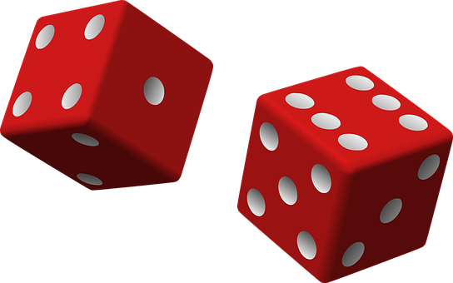
Thompson Sampling Algorithm
Use MAP: Assume a Beta(1,1) (Uniform) prior on each unknown probability of reward.

Slide 88
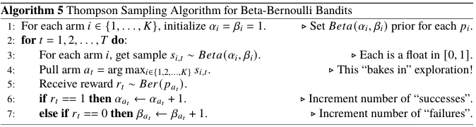
Thompson Sampling Algorithm
Use MAP: Assume a Beta(1,1) (Uniform) prior on each unknown probability of reward.

Slide 89
Thompson Sampling Algorithm
Use MAP: Assume a Beta(1,1) (Uniform) prior on each unknown probability of reward.

Slide 90
Thompson Sampling Algorithm
Use MAP: Assume a Beta(1,1) (Uniform) prior on each unknown probability of reward.

Slide 91
Thompson Sampling Algorithm
Use MAP: Assume a Beta(1,1) (Uniform) prior on each unknown probability of reward.

Slide 92
Thompson Sampling Algorithm
Use MAP: Assume a Beta(1,1) (Uniform) prior on each unknown probability of reward.

Slide 93
Thompson Sampling Algorithm
Use MAP: Assume a Beta(1,1) (Uniform) prior on each unknown probability of reward.
The exploration comes in since we sample from each Beta distribution, rather than just choosing the one with largest expectation or mode (greedy).

Slide 94
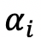
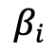
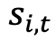
Thompson
Example
Arm ( i ) | True p_{i}
1 | 0.5
2 | 0.2
3 | 0.9
Time ( t ) | Arm Pulled ( a_{t} ) | Reward ( r_{t} )

Slide 95
Thompson
Example
Arm ( i ) | True p_{i}
1 | 0.5 | 1 | 1
2 | 0.2 | 1 | 1
3 | 0.9 | 1 | 1
Time ( t ) | Arm Pulled ( a_{t} ) | Reward ( r_{t} )
1

Slide 96
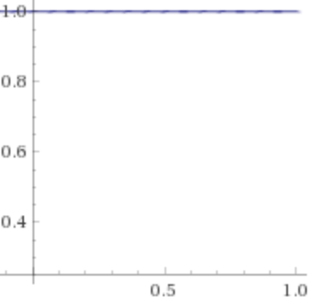
Thompson
Example
Arm ( i ) | True p_{i}
1 | 0.5 | 1 | 1 | 0.43
2 | 0.2 | 1 | 1
3 | 0.9 | 1 | 1
Time ( t ) | Arm Pulled ( a_{t} ) | Reward ( r_{t} )
1
Sample from Beta(1,1) density →

Slide 97
Thompson
Example
Arm ( i ) | True p_{i}
1 | 0.5 | 1 | 1 | 0.43
2 | 0.2 | 1 | 1 | 0.75
3 | 0.9 | 1 | 1
Time ( t ) | Arm Pulled ( a_{t} ) | Reward ( r_{t} )
1
Sample from Beta(1,1) density →

Slide 98
Thompson
Example
Arm ( i ) | True p_{i}
1 | 0.5 | 1 | 1 | 0.43
2 | 0.2 | 1 | 1 | 0.75
3 | 0.9 | 1 | 1 | 0.11
Time ( t ) | Arm Pulled ( a_{t} ) | Reward ( r_{t} )
1
Sample from Beta(1,1) density →

Slide 99
Thompson
Example
Arm ( i ) | True p_{i}
1 | 0.5 | 1 | 1 | 0.43
2 | 0.2 | 1 | 1 | 0.75
3 | 0.9 | 1 | 1 | 0.11
Time ( t ) | Arm Pulled ( a_{t} ) | Reward ( r_{t} )
1 | 2
Choose arm with highest sample!

Slide 100
Thompson
Example
Arm ( i ) | True p_{i}
1 | 0.5 | 1 | 1 | 0.43
2 | 0.2 | 1 | 1 | 0.75
3 | 0.9 | 1 | 1 | 0.11
Time ( t ) | Arm Pulled ( a_{t} ) | Reward ( r_{t} )
1 | 2 | 0
Observe reward 1 with probability 0.2 and 0 with probability 0.8.

Slide 101
Thompson
Example
Arm ( i ) | True p_{i}
1 | 0.5 | 1 | 1
2 | 0.2 | 1 | 2
3 | 0.9 | 1 | 1
Time ( t ) | Arm Pulled ( a_{t} ) | Reward ( r_{t} )
1 | 2 | 0
Add a count of 1 to the failures :(.

Slide 102
Thompson
Example
Arm ( i ) | True p_{i}
1 | 0.5 | 1 | 1 | 0.52
2 | 0.2 | 1 | 2
3 | 0.9 | 1 | 1
Time ( t ) | Arm Pulled ( a_{t} ) | Reward ( r_{t} )
2
Sample from Beta(1,1) density →

Slide 103
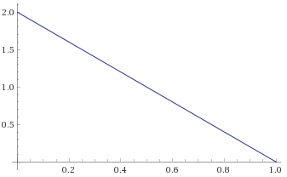
Thompson
Example
Arm ( i ) | True p_{i}
1 | 0.5 | 1 | 1 | 0.52
2 | 0.2 | 1 | 2 | 0.05
3 | 0.9 | 1 | 1
Time ( t ) | Arm Pulled ( a_{t} ) | Reward ( r_{t} )
2
Sample from Beta(1,2) density →

Slide 104
Thompson
Example
Arm ( i ) | True p_{i}
1 | 0.5 | 1 | 1 | 0.52
2 | 0.2 | 1 | 2 | 0.05
3 | 0.9 | 1 | 1 | 0.67
Time ( t ) | Arm Pulled ( a_{t} ) | Reward ( r_{t} )
2
Sample from Beta(1,1) density →

Slide 105
Thompson
Example
Arm ( i ) | True p_{i}
1 | 0.5 | 1 | 1 | 0.52
2 | 0.2 | 1 | 2 | 0.05
3 | 0.9 | 1 | 1 | 0.67
Time ( t ) | Arm Pulled ( a_{t} ) | Reward ( r_{t} )
2 | 3
Choose arm with highest sample!

Slide 106
Thompson
Example
Arm ( i ) | True p_{i}
1 | 0.5 | 1 | 1 | 0.52
2 | 0.2 | 1 | 2 | 0.05
3 | 0.9 | 1 | 1 | 0.67
Time ( t ) | Arm Pulled ( a_{t} ) | Reward ( r_{t} )
2 | 3 | 1
Observe reward 1 with probability 0.9 and 0 with probability 0.1.

Slide 107
Thompson
Example
Arm ( i ) | True p_{i}
1 | 0.5 | 1 | 1
2 | 0.2 | 1 | 2
3 | 0.9 | 2 | 1
Time ( t ) | Arm Pulled ( a_{t} ) | Reward ( r_{t} )
2 | 3 | 1
Add a count of 1 to the successes :).

Slide 108
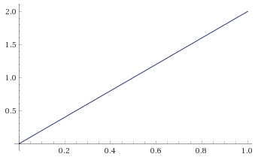
Thompson
Example
Arm ( i ) | True p_{i}
1 | 0.5 | 1 | 1 | 0.44
2 | 0.2 | 1 | 2 | 0.27
3 | 0.9 | 2 | 1 | 0.86
Time ( t ) | Arm Pulled ( a_{t} ) | Reward ( r_{t} )
3
Beta(2,1)
Sample from each arm’s Beta distribution →
Beta(1,1)
Beta(1,2)

Slide 109
Thompson
Example
Arm ( i ) | True p_{i}
1 | 0.5 | 1 | 1 | 0.44
2 | 0.2 | 1 | 2 | 0.27
3 | 0.9 | 2 | 1 | 0.86
Time ( t ) | Arm Pulled ( a_{t} ) | Reward ( r_{t} )
3 | 3 | 0
Observe reward 1 with probability 0.9 and 0 with probability 0.1.

Slide 110
Thompson
Example
Arm ( i ) | True p_{i}
1 | 0.5 | 1 | 1 | 0.44
2 | 0.2 | 1 | 2 | 0.27
3 | 0.9 | 2 | 2 | 0.86
Time ( t ) | Arm Pulled ( a_{t} ) | Reward ( r_{t} )
3 | 3 | 0
Add a count of 1 to the failures :(.

Slide 111
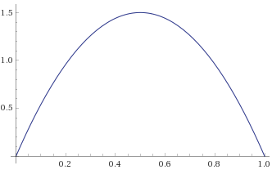
Thompson
Example
Arm ( i ) | True p_{i}
1 | 0.5 | 1 | 1 | 0.63
2 | 0.2 | 1 | 2 | 0.15
3 | 0.9 | 2 | 2 | 0.44
Time ( t ) | Arm Pulled ( a_{t} ) | Reward ( r_{t} )
4
Sample from each arm’s Beta distribution →
Beta(1,1)
Beta(2,2)
Beta(1,2)

Slide 112
Thompson
Example
Arm ( i ) | True p_{i}
1 | 0.5 | 1 | 1 | 0.63
2 | 0.2 | 1 | 2 | 0.15
3 | 0.9 | 2 | 2 | 0.44
Time ( t ) | Arm Pulled ( a_{t} ) | Reward ( r_{t} )
4
And so on!!! Notice how we explore because there’s some chance the “best” arm will have a lower sample occasionally and let other arms win!

Slide 113
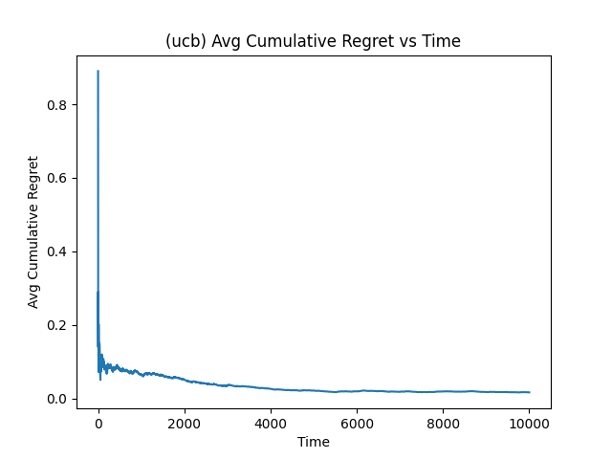
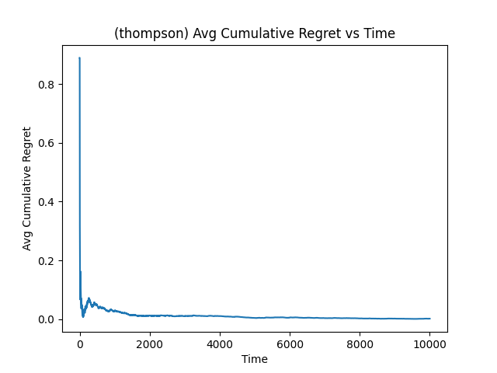
UCB Vs Thompson Sampling: Avg Regret over Time

Slide 114
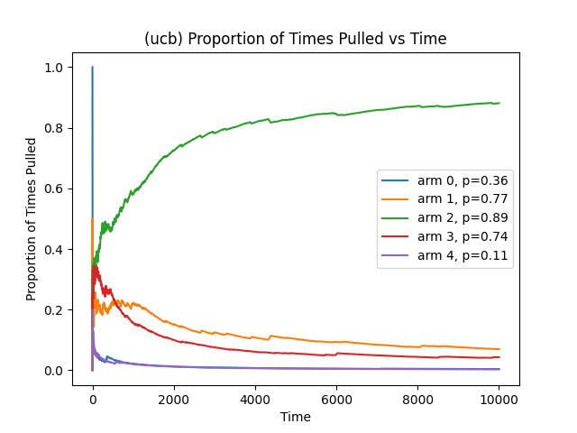
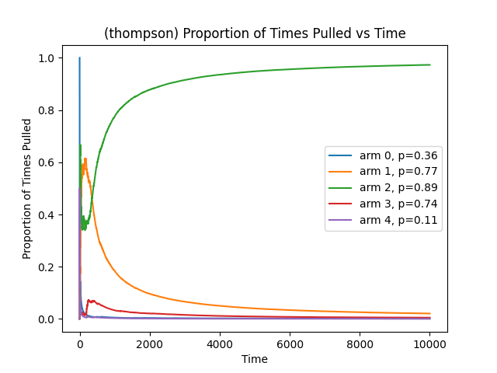
UCB Vs Thompson Sampling: Proportion of Times Pulled

Slide 115

Traditional A/B (Hypothesis) Testing
A large company wants to experiment releasing a new feature/modification.
Assign
99% of population to control group (current feature)
1% to experimental group (new feature).

Slide 116
Traditional A/B (Hypothesis) Testing
A large company wants to experiment releasing a new feature/modification.
Assign
99% of population to control group (current feature)
1% to experimental group (new feature).
This has the following consequences:
If the new feature is “bad”, very small percentage of the population sees it, so company protects itself.

Slide 117
Traditional A/B (Hypothesis) Testing
A large company wants to experiment releasing a new feature/modification.
Assign
99% of population to control group (current feature)
1% to experimental group (new feature).
This has the following consequences:
If the new feature is “bad”, very small percentage of the population sees it, so company protects itself.
If the new feature is “good”, very small percentage of the population sees it, so company may lose revenue.

Slide 118
Traditional A/B (Hypothesis) Testing
A large company wants to experiment releasing a new feature/modification.
Assign
99% of population to control group (current feature)
1% to experimental group (new feature).
This has the following consequences:
If the new feature is “bad”, very small percentage of the population sees it, so company protects itself.
If the new feature is “good”, very small percentage of the population sees it, so company may lose revenue.
Can we do better? Can we adaptively assign subjects to each group based on how each is performing rather than deciding at the beginning?

Slide 119

Traditional A/B (Hypothesis) Testing
A large company wants to experiment releasing a new feature/modification.
Assign
99% of population to control group (current feature)
1% to experimental group (new feature).
This has the following consequences:
If the new feature is “bad”, very small percentage of the population sees it, so company protects itself.
If the new feature is “good”, very small percentage of the population sees it, so company may lose revenue.
Can we do better? Can we adaptively assign subjects to each group based on how each is performing rather than deciding at the beginning?
Bandits!

Slide 120

Modern A/B (Hypothesis) Testing
A large company wants to experiment releasing a new feature/modification.
Assign
Arm 1: Current Feature
Arm 2: New feature

Slide 121
Modern A/B (Hypothesis) Testing
A large company wants to experiment releasing a new feature/modification.
Assign
Arm 1: Current Feature
Arm 2: New feature
When feature is requested by some user, use Multi-Armed Bandit algorithm to decide which feature to show!

Slide 122
Modern A/B (Hypothesis) Testing
A large company wants to experiment releasing a new feature/modification.
Assign
Arm 1: Current Feature
Arm 2: New feature
When feature is requested by some user, use Multi-Armed Bandit algorithm to decide which feature to show!
(Can have any number of features/arms)

Slide 123
Modern A/B (Hypothesis) Testing
When to use Traditional A/B Testing:
Need to collect data for critical business decisions.
Need statistical confidence in all your results and impact. Want to learn even about treatments that didn’t perform well.
The reward is not immediate (e.g., if drug testing, don’t have time to wait for each patient to finish before experimenting with next patient).
Optimize/measure multiple metrics, not just one.

Slide 124
Modern A/B (Hypothesis) Testing
When to use Traditional A/B Testing:
Need to collect data for critical business decisions.
Need statistical confidence in all your results and impact. Want to learn even about treatments that didn’t perform well.
The reward is not immediate (e.g., if drug testing, don’t have time to wait for each patient to finish before experimenting with next patient).
Optimize/measure multiple metrics, not just one.
When to use Multi-Armed Bandits:
No need for interpreting results, just maximize reward (typically revenue/engagement)
The opportunity cost is high (if advertising a car, losing a conversion is >=$20,000)
Can add/remove arms in the middle of an experiment! Cannot do with A/B tests.

Slide 125
Modern A/B (Hypothesis) Testing
When to use Traditional A/B Testing:
Need to collect data for critical business decisions.
Need statistical confidence in all your results and impact. Want to learn even about treatments that didn’t perform well.
The reward is not immediate (e.g., if drug testing, don’t have time to wait for each patient to finish before experimenting with next patient).
Optimize/measure multiple metrics, not just one.
When to use Multi-Armed Bandits:
No need for interpreting results, just maximize reward (typically revenue/engagement)
The opportunity cost is high (if advertising a car, losing a conversion is >=$20,000)
Can add/remove arms in the middle of an experiment! Cannot do with A/B tests.
The study of Multi-Armed Bandits can be categorized as:
Statistics
Optimization
“Reinforcement Learning” (subfield of Machine Learning)

Slide 126
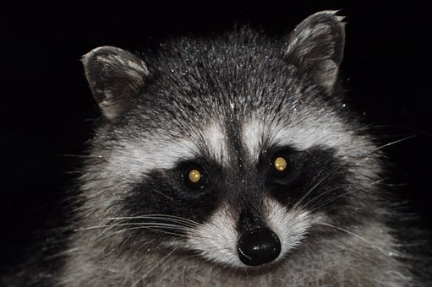
END PIC
Alex Tsun

Slide 127
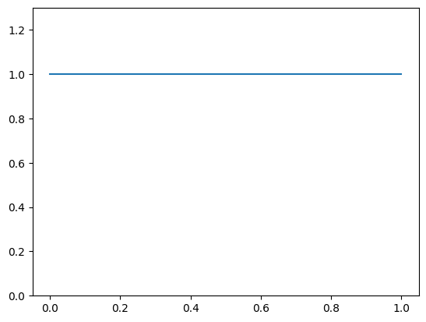
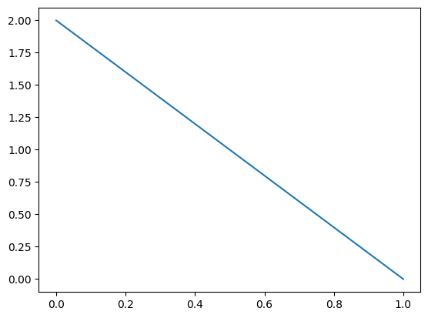
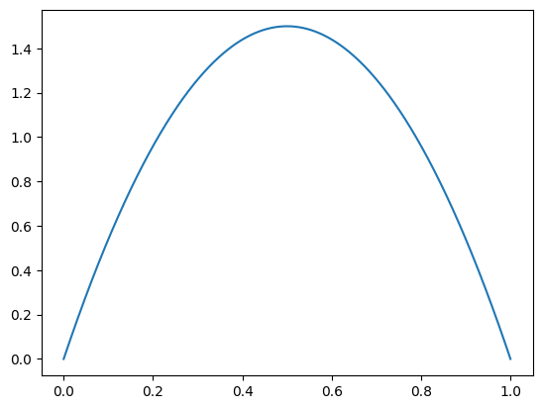
Beta(1,1)
Arm ( i ) | True p_{i}
1 | 0.5 | 1 | 1 | 0.44
2 | 0.2 | 1 | 2 | 0.27
3 | 0.9 | 2 | 2 | 0.86
Beta(1,2)
Sample from each arm’s Beta distribution
Beta(2,2)

